Slide 1
Atlas-12: Personalized AI Agent for Emerging Markets
Atlas Inc

Slide 2
Introductions

Slide 3
High Cost of Equal Opportunity Education
Our company started off since our founders felt that everyone should have an equal opportunity for education
Developed countries like the United States, Europe, and Canada have some of the education systems that are highly sought
Emerging markets’ education systems are highly competitive, a personalized / personable tutor agent can help level the playing field for those that can’t afford expensive tutoring programs
One data point is that top programs in India can cost a family $18,678.95 USD annually

Slide 4
Target Customer for MVP
We started with emerging markets based on taking advantage of population density
We have monitored the Indian market for the past few years and believe that now [2024-2025] is the popular time to pilot our new AI engine in India
If we are able to get a 5% of the TAM ($4M - $121M) in India we have been able to reach our 1st milestone and try to expand in the Latin America markets

Slide 5


Solution - Company Name: Atlas 12
Mission Statement: To create innovative solutions to democratize education for all.
Let's take schools into the cloud!

Slide 6
Major KPIs
Daily active users
How long and how often users leverage our service
Rate of new users joining the platform
% of users that have signed up in the past month
Confidence in the Plan
We are asking the users how likely they are to refer the service / application
Increase in school grades / college admissions
Increase in report card grades and how many of our students are able to attend higher education of their choice

Slide 7
Team’s Roadmap
Target Date | Milestone | Description | Exit Criteria
2024-08-01 | Pilot | Internal testing of tooling | No P0 or P1 bugs found during consecutive 3 months of usage
2024-10-01 | Beta | 25 students enrolled | At least 10 of the 25 students give a 3.0 or lower NPS
2025-01-01 | Launch of MVP | Open enrollment in developing markets | Measure success of seasonal accuracy & general trends of DAUs

Slide 8

Companies Finances

Slide 9
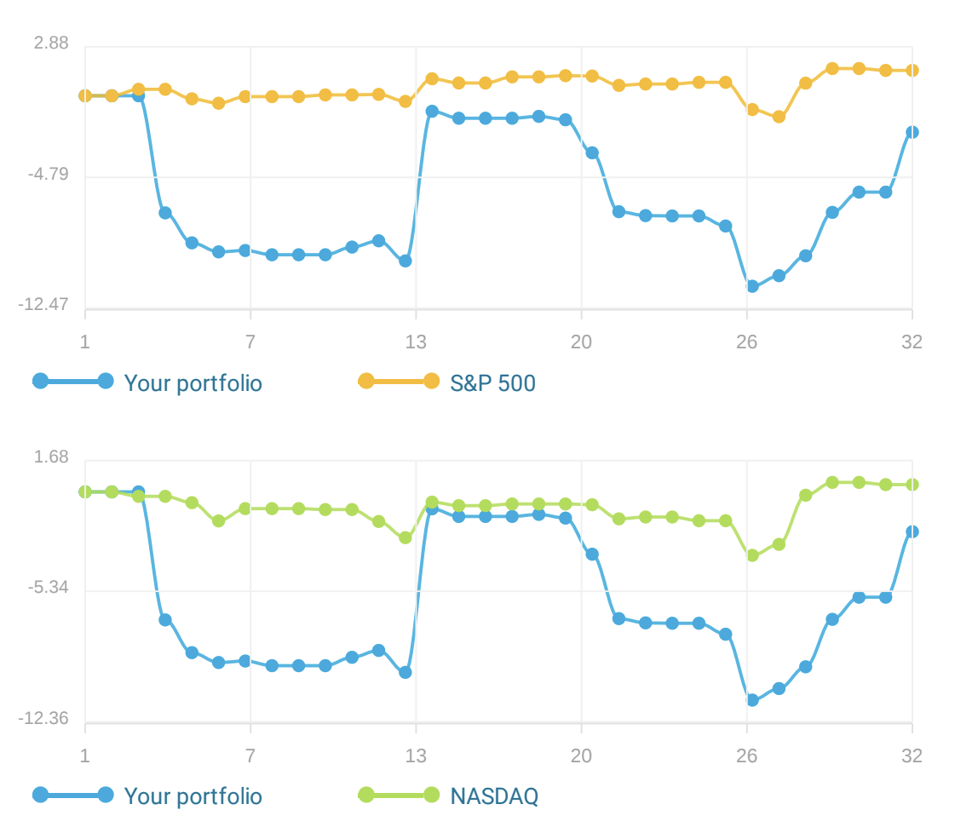
Time Weighted Returns for past 3 months of
February - April 2023
Notes:
Our sharpe ratio .

Slide 10
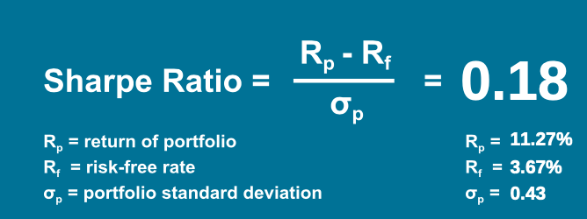
Random Capital LLC - Sharpe Ratio

Slide 11
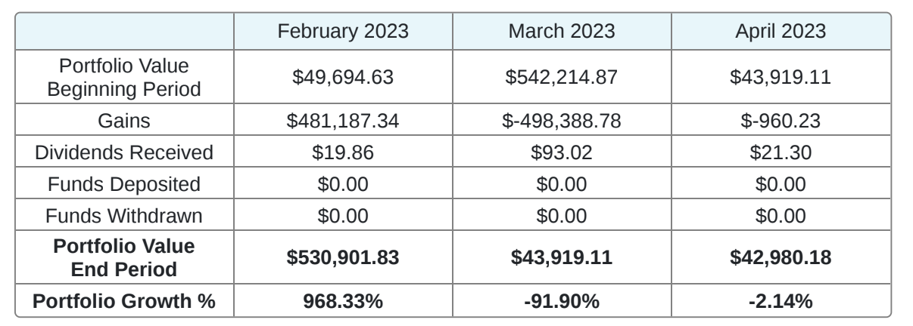
Atlas Inc Revenue

Slide 12
Our Future Vision
A personal tutor or trainer for any child or adult who wants it, available anywhere in the world
Ideally we want this be a free service, however to bootstrap the company we will start as a Software as a Service company following a free-ium pricing model

Slide 13
Questions & Feedback

